Slide 1
FREP Visual Sample DNI-019
Sample date Nov 10, 2010

Slide 2
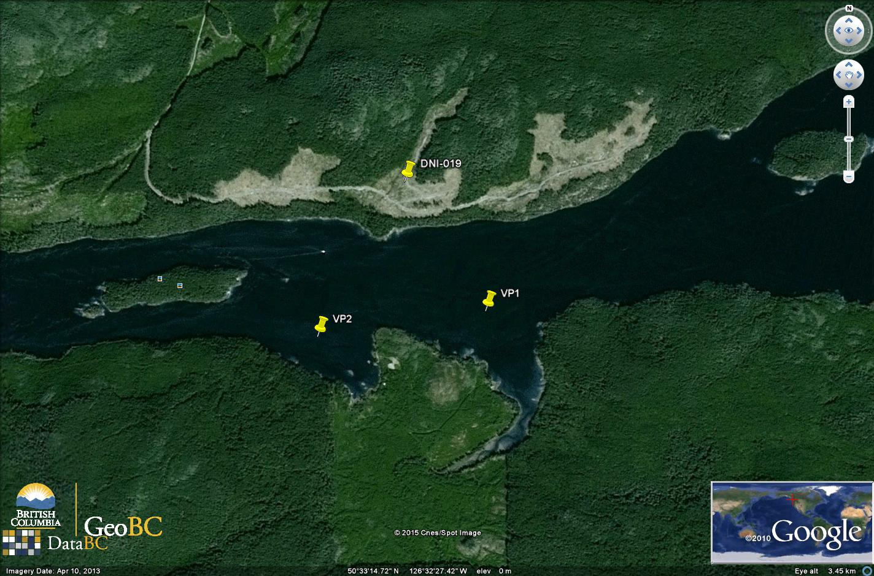
Location: Broughton/Islands

Slide 3
Established VQO
Partial Retention (easy to see, small to moderate in scale, and has a design that appears natural and is not angular or geometric)
Modification (large in scale with a design that is natural in appearance or small to moderate in scale but with a design that has some angular characteristics)

Slide 4
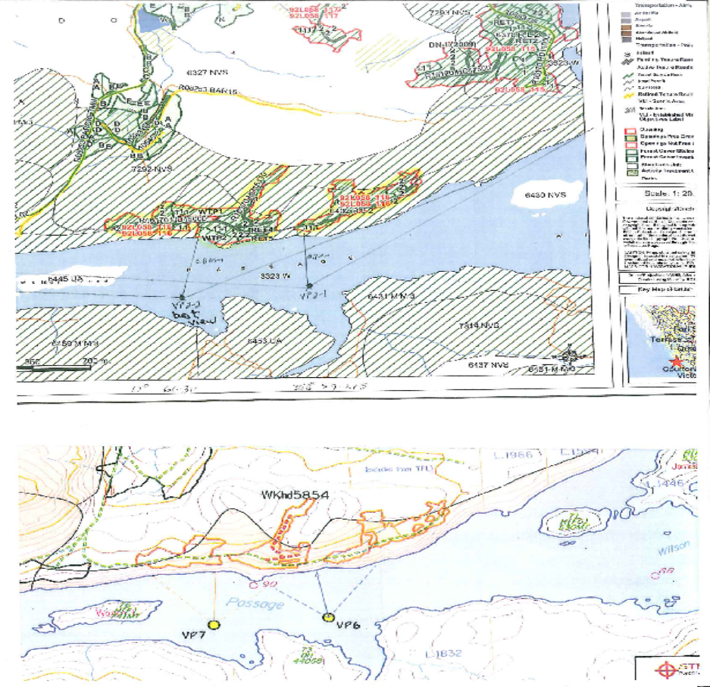
VIA VPs vs FREP VPs
1
Notes:
The VIA and FREP assessments used essentially the same viewpoints (chosen completely independently). This tends to confirm the chosen VPs are appropriate.

Slide 5
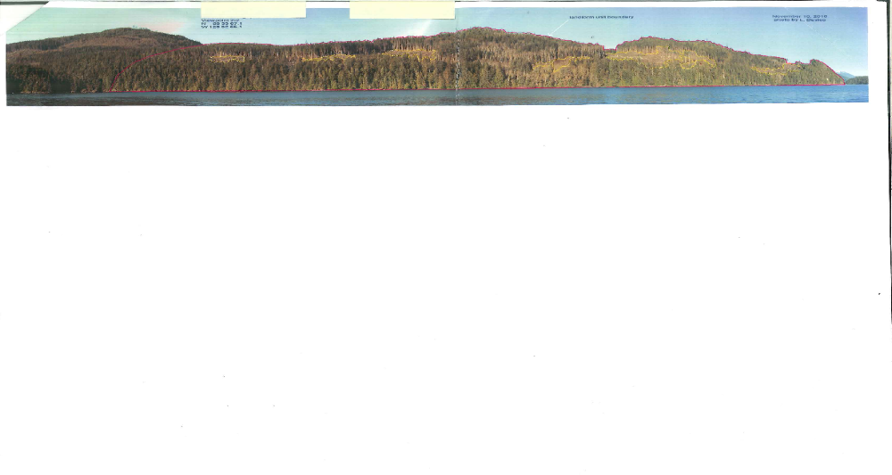
VP2 Panorama Alteration
Alteration is 8.5% (adjusted for design)

Slide 6
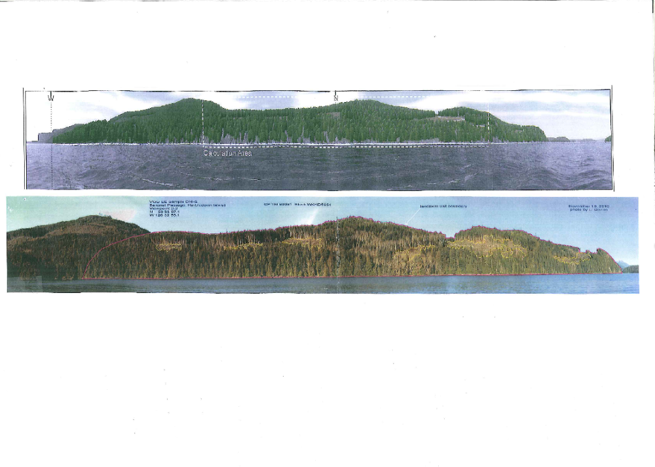
VIA Simulation vs Photo
Notes:
2007 VIA comments: Assessment included 2 VPs in vicinity of block, and confirmed that “the visual disturbance of the proposed alterations adhere to the definition of the VQO categories specific to this area.” The total % alteration from one VP was 1.7% and from the second VP was 2.5%.
The SP for the block summarized the VIA results and said that “All viewpoints used meet the recommended numerical alteration for partial retention of 1.6-7.0% and the definition of partial retention as defined in Section 1.1 of FPPR.”

Slide 7
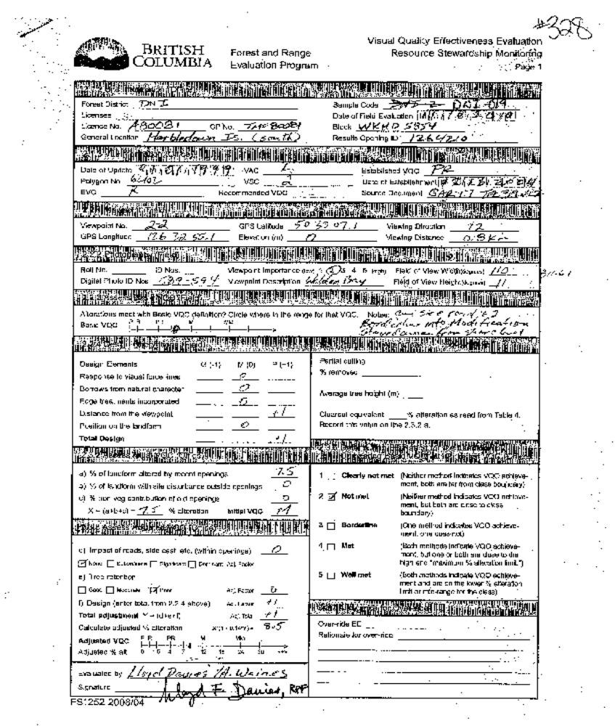
VP2 Checklist
Notes:
FLNR staff (Andy Waines, Christina Mardell and Lloyd Davies) assessed this block on November 10, 2010 (via Don Wilson water taxi). The lighting conditions and visibility were good. We found that the block had several parcels visible from the water on a long continuous shoreline landform. From VP1 (mid-channel) the response to visual force lines was good and we felt the design borrowed from the natural character of the landform. The basic definition was met (central PR) and the adjusted percent alteration was 5.8%. Therefore, the PR VQO was met from VP1. However it was agreed that VP 2 was the more sensitive and best view to use, given it was located near a bay, a relatively rare anchor spot for the area. The viewing distance was slightly less than 1 km from both VPs, giving a poor rating for that design element.

Slide 8
RESULTS
VIA estimated 2.5% alteration (including 0.5% sky) from VP 7, PR met
FREP assessment determined basic VQC to be low modification (due to road, skyline gaps, and multiple parcels)
Initial VQC=M, alteration 7.5 % (8.5% adjusted for poor rating on distance from landform), PR not met
Notes:
RESULTS: From VP2 (best view), the block did not meet the basic definition of PR because you could see the road in the two easternmost parcels, and it was felt the overall impact of multiple parcels pushed it into low Modification territory. The alteration percentage adjusted for design elements (poor distance from VP) was 8.5%. We noted that the block boundary stayed away from both the shoreline and the skyline, which was positive. We also rated the VP importance at 2, on the low end of the 5 point range. That said, neither method indicated that Partial Retention was met, so the block was rated “Not Met” from VP2.

Slide 9
Opportunities For Improvement:
Conduct post-harvest assessments to compare actual results to projected results.
Take advantage of local topography, and ensure openings appear in keeping with the natural landform characteristics.
Avoid angular corners, creating skyline gaps, or scattered residual trees along ridgelines.
Use appropriate block size, natural shapes, lower/lateral location on landform, and strategic retention within blocks to limit visual impacts, especially on smaller coastal landform units.
Incorporate visual design concepts and principles during planning in scenic areas.

Slide 10
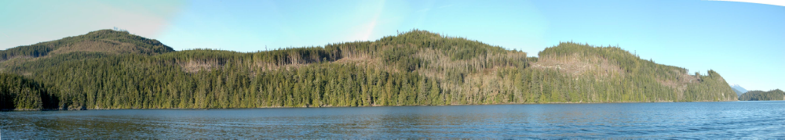
Questions?

